Slide 1
Basic & Intermediate R
BY
LUCY WANGARI

Slide 2
LESSON 1
Introduction to Visualizations

Slide 3
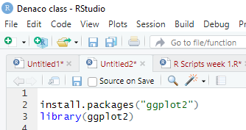
Introduction to the ggplot2 package
You can install ggplot2 and activate it by executing the following commands
A graph is made up of a series of layers. You can think of a layer as a plastic transparency with something printed on it. That ‘something’ could be text, data points, lines, bars, pictures of chickens, or pretty much whatever you like. To make a final image, these transparencies are placed on top of each other.
Visual elements are known as geoms (short for ‘geometric objects’)
Therefore, when we define a layer, we have to tell R what geom we want displayed on that layer
Do we want a bar, line dot, etc.?.
These geoms also have aesthetic properties that determine what they look like and where they are plotted
do we want red bars or green ones? do we want our data point to be a triangle or a square? etc.).
These aesthetics (aes() for short) control the appearance of graph elements (for example, their colour, size, style and location).
Aesthetics can be defined in general for the whole plot, or individually for a specific layer

Slide 4
Syntax
myGraph <- ggplot(myData, aes(variable for x axis, variable for y axis))
Example
If we wanted our layers/geoms to display data from males and females in different colours then we could specify (assuming the variable gender defines whether a datum came from a man or a woman)
myGraph <- ggplot(myData, aes(variable for x axis, variable for y axis, colour = gender))
At this level you can also define options using the opts() function. The most common option to set at this level is a title: + opts(title = "Title")
So far we have created only the graph object: there are no graphical elements, and if you try to display myGraph you’ll get an error. We need to add layers to the graph containing geoms or other elements such as labels. To add a layer we literally use the ‘add’ symbol (+). So, let’s assume we want to add bars to the plot, we can execute this command:
myGraph + geom_bar()
This command takes the object myGraph that we have already created, and adds a layer containing bars to it.
Now that there are graphical elements, ggplot2 will print the graph to a window on your screen. If we want to also add points representing the data to this graph then we add ‘+ geom_point()’ to the command and rerun it:
myGraph + geom_bar() + geom_point(

Slide 5
Syntax
ggplot(data, mapping=aes()) +
geometric object
arguments:
data: Dataset used to plot the graph
mapping: Control the x and y-axis
geometric object: The type of plot you want to show. The most common object are:
- Point: `geom_point()`
- Bar: `geom_bar()`
- Line: `geom_line()`
- Histogram: `geom_histogram()`

Slide 6
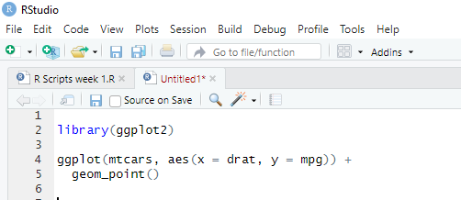
R Scatterplots
A scatterplot is a graph in which the values of two variables are plotted along two axes, with the pattern of the resulting points revealing any correlation present.
Example
You first pass the dataset mtcars to ggplot.
Inside the aes() argument, you add the x-axis and y-axis.
The + sign means you want R to keep reading the code. It makes the code more readable by breaking it.
Use geom_point() for the geometric object.
There are times when it makes sense to use the logarithmic scales in charts and graphs. One reason is to respond to skewness towards large values, i.e, cases in which one or a few points are much larger than the bulk of the data.
Create the graph again, but this time use the log() function on the totalacres column. ggplot(data=sm) + geom_point(mapping = aes(x=YEAR_, y=log(totalacres)))

Slide 7
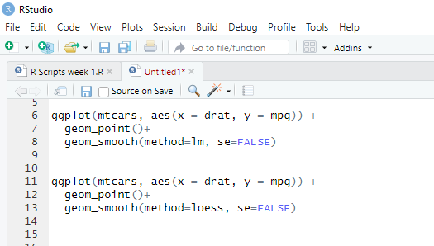
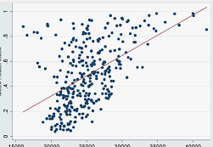
Adding a regression line to the scatterplot
Plots constructed with ggplot() can have more than one geometry. It’s common to add a prediction (regression) line to the plot.
There are several ways that you can add a regression line to the scatterplot, one of which is to use the geom_smooth() function with the method set to lm (straight line) and the se parameter set to FALSE.
You can add a confidence interval around the regression line by setting se = TRUE.

Slide 8
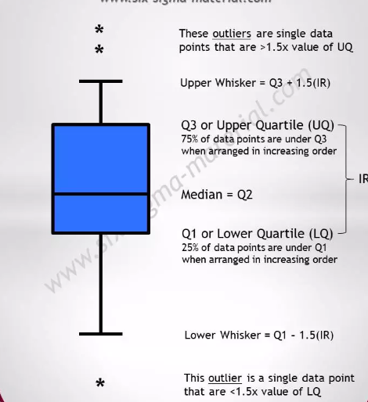
Boxplot () in R
Boxplots or box–whisker diagrams are really useful ways to display your data.
At the center of the plot is the median, which is surrounded by a box the top and bottom of which are the limits within which the middle 50% of observations fall (the interquartile range).
Sticking out of the top and bottom of the box are two whiskers that extend to one and a half times the interquartile range.
Load the data
Import the data
Drop unnecessary variables
Convert Month in factor level
Create a new categorical variable dividing the month with three level: begin, middle and end.
Remove missing observations
All these steps are done with dplyr and the pipeline operator %>%.

Slide 9
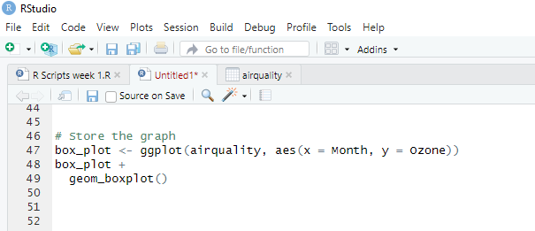
Boxplot () in R
An outlier is an extreme score, so the easiest way to find it is to sort the data
Let’s look now in more detail about what the boxplot represents. First, it shows us the lowest score (the lowest point of the bottom whisker, or a dot below it) and the highest (the highest point of the top whisker of each plot, or a dot above it). The lowest edge of the white box is the lower quartile therefore, the distance between the bottom of the vertical line and the lowest edge of the white box is the range between which the lowest 25% of scores fall. The box (the white area) shows the interquartile range that is, 50% of the scores are bigger than the lowest part of the white area but smaller than the top part of the white area.

Slide 10
Boxplot () in R
The top edge of the white box shows the value of the upper quartile therefore, the distance between the top edge of the white box and the top of the vertical line shows the range between which the top 25% of scores fall. In the middle of the white box is a line that represents the value of the median.
Boxplots show us the range of scores, the range between which the middle 50% of scores fall, and the median, the upper quartile and lower quartile score. Like histograms, they also tell us whether the distribution is symmetrical or skewed.
If the whiskers are the same length then the distribution is symmetrical (the range of the top and bottom 25% of scores is the same); however, if the top or bottom whisker is much longer than the opposite whisker then the distribution is asymmetrical (the range of the top and bottom 25% of scores is different).
Finally, you’ll notice some dots above the boxplot. These are cases that are deemed to be outliers

Slide 11
LESSON 2
Charts

Slide 12
Bar Chart
A bar chart is a great way to display categorical variables in the x-axis. This type of graph denotes two aspects in the y-axis.
The first one counts the number of occurrence between groups.
The second one shows a summary statistic (min, max, average, and so on) of a variable in the y-axis.
Bar charts are a common way for people to display means.
The ggplot2 package does not differentiate between research designs, so you plot bar charts in the same way regardless of whether you have an independent, repeated-measures or mixed design.

Slide 13
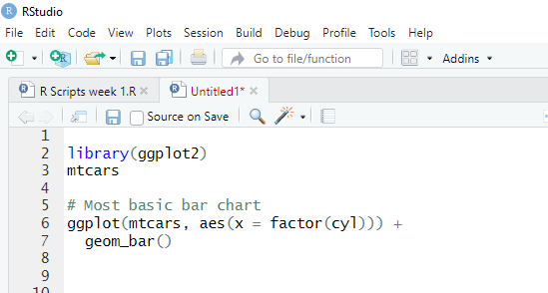
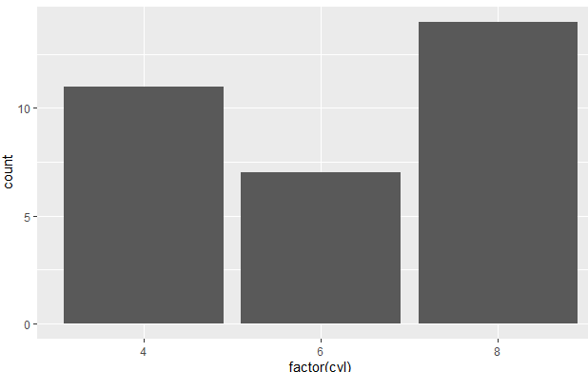
Bar charts for one independent variable
We can set this up by first creating the plot object and defining any aesthetics that apply to the plot as a whole.
I have called the object bar, and have created it using the ggplot() function. The function specifies the dataframe
to be used and has set film to be plotted on the x-axis, and arousal to be plotted on the y-axis:
Example
Note: make sure you convert the variables into a factor otherwise R treats the variables as numeric

Slide 14
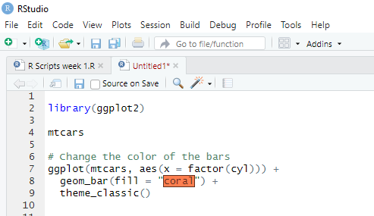
Customize the graph
Four arguments can be passed to customize the graph:
- `stat`: Control the type of formatting. By default, `bin` to plot a count in the y-axis. For continuous value, pass `stat = "identity"`
- `alpha`: Control density of the color
- `fill`: Change the color of the bar
- `size`: Control the size the bar
You can change the color of the bars.
Note that the colors of the bars are all similar.

Slide 15
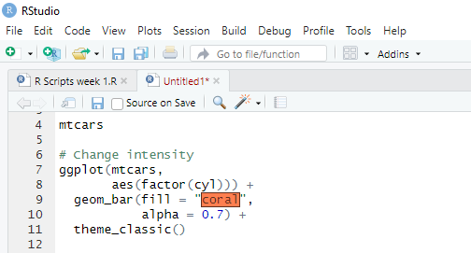
Change the intensity
You can increase or decrease the intensity of the bars’ color
To increase/decrease the intensity of the bar, you can change the value of the alpha. A large alpha increases the intensity, and low alpha reduces the intensity. alpha ranges from 0 to 1. If 1, then the color is the same as the palette. If 0, color is white. You choose alpha = 0.1.

Slide 16
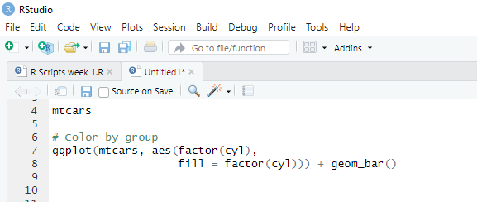
Color by groups
You can change the colors of the bars, meaning one different color for each group. For instance, cyl variable has three levels, then you can plot the bar chart with three colors.
The argument fill inside the aes() allows changing the color of the bar. You change the color by setting fill = x-axis variable. In your example, the x-axis variable is cyl; fill = factor(cyl)

Slide 17
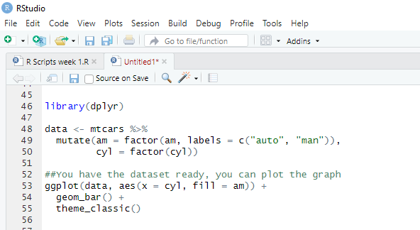
Add a group in the bars
You can further split the y-axis based on another factor level. For instance, you can count the number of automatic and manual transmission based on the cylinder type.
Create the data frame with mtcars dataset
Label the am variable with auto for automatic transmission and man for manual transmission. Convert am and cyl as a factor so that you don’t need to use factor() in the ggplot() function.
Plot the bar chart to count the number of transmission by cylinder

Slide 18
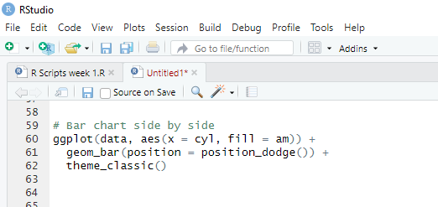
Side by side bars
It is easy to plot the bar chart with the group variable side by side.
position=position_dodge(): Explicitly tells how to arrange the bars

Slide 19
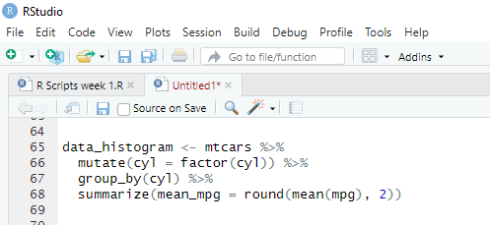
Histograms
Histogram is a type of bar chart that is used to represent statistical information by way of bars to display the frequency distribution of continuous data. It indicates the number of observations that lie in-between the range of values, which is known as class or bin.
A histogram chart helps you to display the distribution of numerical data by rendering vertical bars. You can compare non-discrete values with the help of a histogram chart.
1. Create a new variable
You create a data frame named data_histogram which simply returns the average miles per gallon by the number of cylinders in the car. You call this new variable mean_mpg, and you round the mean with two decimals.

Slide 20
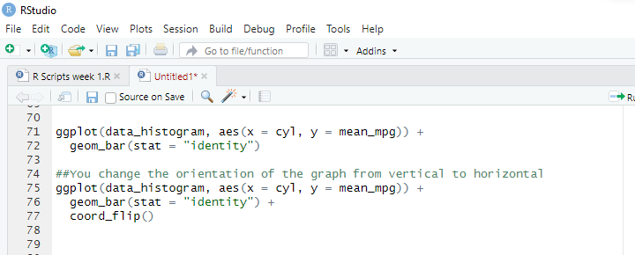
Histograms
2. Create a basic histogram
You can plot the histogram. It is not ready to communicate to be delivered to client but gives us an intuition about the trend.
You need to pass the argument stat=”identity” to refer the variable in the y-axis as a numerical value. geom_bar uses stat=”bin” as default value.
You can control the orientation of the graph with coord_flip()

Slide 21
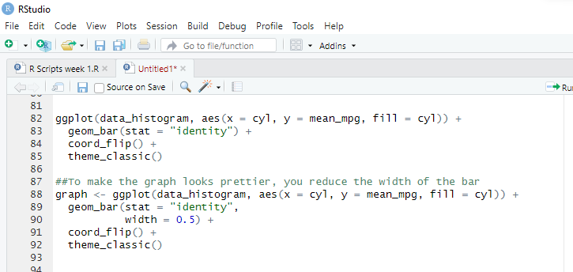
Histograms
3. Change the color
You can plot the graph by groups with the fill= cyl mapping. R takes care automatically of the colors based on the levels of cyl variable
The width argument inside the geom_bar() controls the size of the bar. Larger value increases the width.
Note, you store the graph in the variable graph. You do so because the next step will not change the code of the variable graph. It improves the readability of the code.

Slide 22
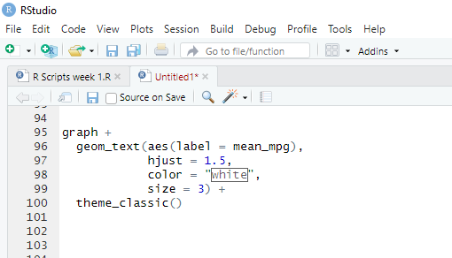
Histograms
4. Add labels to the graph
The function geom_text() is useful to control the aesthetic of the text.
label=: Add a label inside the bars
mean_mpg: Use the variable mean_mpg for the label
hjust controls the location of the label. Values closed to 1 displays the label at the top of the bar, and higher values bring the label to the bottom. If the orientation of the graph is vertical, change hjust to vjust.
color=”white”: Change the color of the text. Here you use the white color.
size=3: Set the size of the text.

Slide 23
LESSON 3
Comparing Means

Slide 24
The T-test
It can be used to test whether a correlation coefficient is different from 0; it can also be used to test whether a regression coefficient, b, is different from 0. However, it can also be used to test whether two group means are different.
The T-Test belongs to the family of inferential statistics. It is commonly employed to find out if there is a statistical difference between the means of two groups.
The basic idea behind a T-Test is to use statistics to evaluate two contrary hypotheses:
The average is the same as the sample used
The average is different from the sample used
The T-test is commonly used with small sample sizes. To perform a t-test, you need to assume normality of the data
The basic syntax for t.test() in R is
t.test(x, y = NULL,
mu = 0, var.equal = FALSE)
- x : A vector to compute the one-sample t-test
- y: A second vector to compute the two sample t-test
- mu: Mean of the population- var.equal: Specify if the variance of the two vectors are equal. By default, set to `FALSE`

Slide 25
Assumptions of the T-test
Given that the t-test is basically regression, it has much the same assumptions. Both the independent t-test and the dependent t-test are parametric tests based on the normal distribution .
Therefore, they assume
The sampling distribution is normally distributed. In the dependent t-test this means that the sampling distribution of the differences between scores should be normal, not the scores themselves measured at least at the interval level.
The independent t-test, because it is used to test different groups of people, also assumes:
Scores in different treatment conditions are independent (because they come from different people).
Homogeneity of variance – well, at least in theory we assume equal variances, but in reality we don’t

Slide 26
The t-test
One Sample T-Test in R
The One Sample t-test, or student’s test, compares the mean of a vector against a theoretical mean, One Sample T-Test in R. The formula used to compute the t-test is:
Example
Suppose you are a company producing cookies. Each cookie is supposed to contain 10 grams of sugar. The cookies are produced by a machine that adds the sugar in a bowl before mixing everything. You believe the machine does not add 10 grams of sugar for each cookie. If your assumption is true, the machine needs to be fixed. You stored the level of sugar of thirty cookies.
Note: You can create a randomized vector with the function rnorm(). This function generates normally distributed values
rnorm(n, mean, sd)
- n: Number of observations to generate
- mean: The mean of the distribution. Optional
- sd: The standard deviation of the distribution. Optional

Slide 27
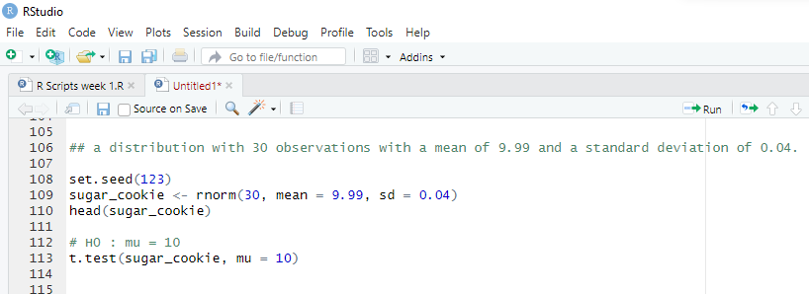
The T-test
One Sample T-Test in R
You can use a one-sample t-test to check whether the level of sugar is different than the recipe. You can draw a hypothesis test:
The average level of sugar is equal to 10
The average level of sugar is different than 10
You use a significance level of 0.05
The p-value of the one sample t-test is 0.1079 and above 0.05. You can be confident at 95% that the amount of sugar added by the machine is between 9.973 and 10.002 grams. You cannot reject the null (H0) hypothesis. There is not enough evidence that amount of sugar added by the machine does not follow the recipe.
µ

Slide 28
The T-test
Paired T-Test in R
The Paired T-test, or dependant sample t-test, is used when the mean of the treated group is computed twice. The basic application of the paired t-test is:
A/B Testing: Compare two variants
Case Control Studies: Before/after treatment
Example
A beverage company is interested in knowing the performance of a discount program on the sales. The company decided to follow the daily sales of one of its shops where the program is being promoted. At the end of the program, the company wants to know if there is a statistical difference between the average sales of the shop before and after the program.
The company tracked the sales everyday before the program started. This is our first vector.
The program is promoted for one week and the sales are recorded every day. This is our second vector.
You will perform the t-test to judge the effectiveness of the program. This is called a paired t-test because the values of both vectors come from the same distribution (i.e., the same shop).
The hypothesis testing is:
No difference in mean
The two means are different
Remember, one assumption in the t-test is an unknown but equal variance. In reality, the data barely have equal mean, and it leads to incorrect results for the t-test.
One solution to relax the equal variance assumption is to use the Welch’s test. R assumes the two variances are not equal by default. In your dataset, both vectors have the same variance, you can set var.equal= TRUE.
You create two random vectors from a Gaussian distribution with a higher mean for the sales after the program.

Slide 29
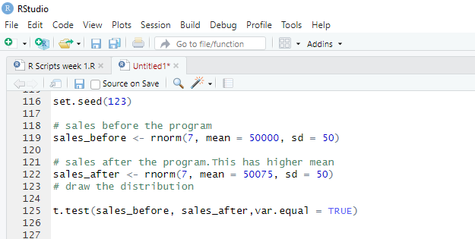
The T-test
Paired T-Test in R
You obtained a p-value of 0.04606, lower than the threshold of 0.05. You conclude the averages of the two groups are significantly different. The program improves the sales of shops.

Slide 30
LESSON 4
Introduction to ANOVA

Slide 31
ANOVA
When we perform a t-test, we test the hypothesis that the two samples have the same mean. Similarly, ANOVA tells us whether three or more means are the same, so it tests the null hypothesis that all group means are equal. An ANOVA produces an F-statistic or F-ratio, which is similar to the t-statistic in that it compares the amount of systematic variance in the data to the amount of unsystematic variance. In other words, F is the ratio of the model to its error. ANOVA is an omnibus test, which means that it tests for an overall effect: so, it does not provide specific information about which groups were affected
Suppose an experiment was conducted with three different groups, and the F-ratio tells us that the means of these three samples are not equal (i.e., that X X 1 2 = = X3 is not true). There are several ways in which the means can differ.
The first possibility is that all three sample means are significantly different ( X X 1 2 ≠ ≠ X3 ).
A second possibility is that the means of groups 1 and 2 are the same but group 3 has a significantly different mean from both of the other groups ( X X 1 2 = ≠ X3 ).
Another possibility is that groups 2 and 3 have similar means but group 1 has a significantly different mean ( X X 1 2 ≠ = X3 ). Finally, groups 1 and 3 could have similar means but group 2 has a significantly different mean from both ( X X 1 3 2 = ≠ X ). So, in an experiment, the F-ratio tells us only that the experimental manipulation has had some effect, but it doesn’t tell us specifically what the effect was

Slide 32
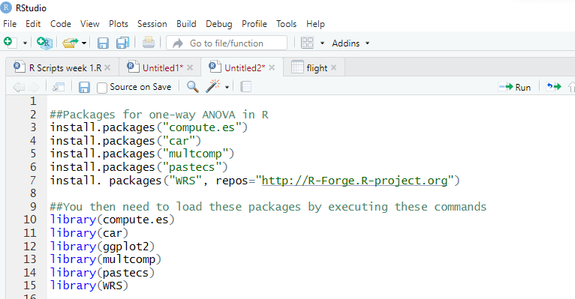
Assumptions of ANOVA
Homogeneity of variance
As with the t-test, there is an assumption that the variances of the groups are equal. This assumption can be tested using Levene’s test, which tests the null hypothesis that the variances of the groups are the same
If Levene’s test is significant (i.e., the p-value is less than .05) then we can say that the variances are significantly different.
This would mean that we had violated one of the assumptions of ANOVA and we would have to take steps to rectify this matter

Slide 33
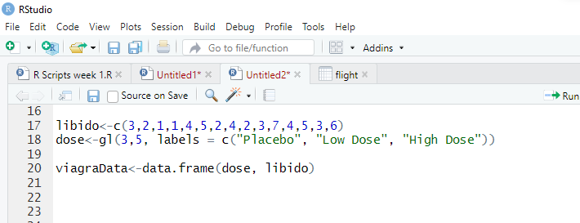
Assumptions of ANOVA
Homogeneity of variance
So, the data must be entered in two columns (one called dose which specifies how much Viagra the participant was given and one called libido which indicates the person’s libido over the following week).
The data are in the file Viagra.dat, but I recommend entering them by hand to gain practice in data entry. I have coded the grouping variable so that 1 = placebo, 2 = low dose and 3 = high

Slide 34
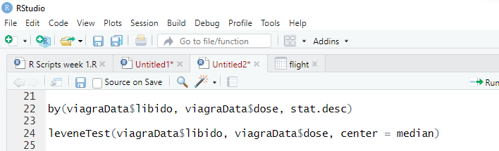
Exploring the Data
To get some descriptive statistics for each group we can use the by() function.
Remember that this function takes the general form:
by(variable, group, output)
variable is the object that you want to summarize (in this case libido),
group is the variable that defines the groups by which you want to organize the output (in this case dose)
output is a function that tells R what output you would like to see (i.e., the mean).
If we use the function stat.desc() from the package pastecs then R will output a host of useful descriptive statistics. Therefore, by combining by() and stat.desc(), we can get a table of descriptives for each group in a single line of code:
So, if we want to do a Levene’s test to see whether the variance in libido (the outcome) varies across groups that received different doses of the drug (dose), we can execute:
The output shows that Levene’s test is very non-significant, F(2, 12) = 0.118, p = .89. This means that for these data the variances are very similar (hence the high probability value); in fact, if you look at Output you’ll see that the variances of the placebo and low-dose groups are identical.

Slide 35
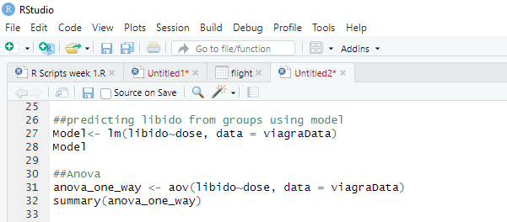
One-way ANOVA
compares the mean between multiple groups.
syntax for an ANOVA test
aov(formula, data)
- formula: The equation you want to estimate
data: The dataset used
Example

Slide 36
One-way ANOVA
Compares the mean between multiple groups.
The output is divided into effects due to the model (the experimental effect) and residuals (this is the unsystematic variation in the data).
The effect labelled dose is the overall experimental effect. In this row we are told the sums of squares for the model (SSM = 20.13)
The degrees of freedom are equal to 2 and the mean squares value for the model corresponds to that calculated in section 10.2.8 (10.067).
The sum of squares and mean squares represent the experimental effect. The row labelled Residuals gives details of the unsystematic variation within the data (the variation due to natural individual differences in libido and different reactions to Viagra).
The table tells us how much unsystematic variation exists (the residual sum of squares, SSR)

Slide 37
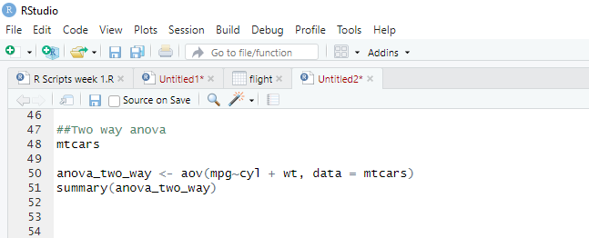
Two-way ANOVA
A two-way ANOVA test adds another group variable to the formula. It is identical to the one-way ANOVA test, though the formula changes slightly: y=x1+x2 with is a quantitative variable and and are categorical variables.
We adjust our code by adding treat with the other independent variable.

